Slide 1
Antigen-Antibody Reactions

Slide 2
Antigen-Antibody Reactions
When a molecules of antigen and corresponding antibody are brought together in solution combined with each others and may be an observable product.
The reaction formed between a specific epitope of antigen and paratope of antibody.
The Ag –Ab reactions are reversible and highly specific

Slide 3
General feature of antigen antibody reactions
The reaction is specific; an antigen combines only with its homologous antibody ,however is not absolute and cross reactions may occur due to antigenic similarity.
Entire molecules react and not fragment.
There is no denaturation of the antigen or the antibody during the reaction.
The combination occurs at the surface.
The combination is firm and reversible.

Slide 4
Types of Antigen-antibody reactions:
Precipitation
Agglutination
Neutralization (Antitoxins)
Opsonization
Antibody-dependant cell-mediated cytotoxicity

Slide 5
PRECIPITATION
When an antibody binds to a soluble antigen, the antigen becomes insoluble and it may precipitate ,If Ag - Ab complex precipitates, it is referred as "precipitation reaction".
The amount of precipitate depends on : the ratio of (Ag:Ab) and the Ab avidity.
Types of precipitation reactions :
Immunodiffusion
Radial Immunodiffusion
Immunoelectrophoresis

Slide 6
antigen
antibody

Slide 7
Agglutination
The interaction between antibody and a particulate antigen results in visible clumping called agglutination.
Types of agglutination
Slide agglutination: Serotyping.
Tube agglutination: e.g. Widal test.
Indirect (passive agglutination)

Slide 9
Tube agglutination test for determining antibody titer.

Slide 10
When a fixed volume of a particulate antigen suspension is added to an equal volume of serial dilutions of an antiserum in test tubes, the agglutination titre of the serum can be estimated.
Tube agglutination is routinely employed for the serological diagnosis of typhoid, brucellosis and typhus fever

Slide 11
Widal test
The procedure involves adding a suspension of dead typhoid bacterial cells to a series of tubes containing the patient’s serum, which has been diluted out to various concentrations. After the tubes have been incubated for 30 minutes at 37° C, they are centrifuged and examined to note the amount of agglutination that has occurred. The reciprocal of the highest dilution at which agglutination is seen is designated as the antibody titer of the patient’s serum. For example, if the highest dilution at which agglutination occurs is 1:320, the titer is 320 antibody units per milliliter of serum. Naturally, the higher the titer, the greater is the antibody response of the individual to the disease.
Two types of antigens are used, the H or the flagellar antigen and the O or the somatic antigen of the typhoid bacillus.

Slide 12
Hemagglutination is used in blood typing
Agglutination reactions are routinely performed to type red blood cells. In typing for the ABO antigens, RBCs are mixed on a slide with antisera to the A or B blood group antigens. If the antigen is present on the cells, they agglutinate, forming a visible clump on the slide. Determination of which antigens are present on donor and recipient blood is the basis for matching blood types for transfusions.

Slide 13
NEUTRALIZATION
Is the binding of Ab to microbial epitopes or soluble molecules(e.g. toxins) which inhibits their binding to host cells.
Abs are mostly IgG & IgA
Used to identify toxins and viruses
OPSONIZATION
Is the process by which a pathogen is marked (tagged) for ingestion and destruction by phagocytic cells

Slide 14
OPSONIZATION

Slide 15
Antibody-dependant cell-mediated cytotoxicity
Coating of an organism can attract phagocytic cells as well as other cytolytic cells(NK cells, eosinophils).
The organism may be: bacteria, protozoa, parasitic worms.
These cells use cytolytic mechanisms to kill those organisms.

Slide 16
Antigen-Antibody Reactions 2

Slide 17
Immunofluorescence
Fluorescence is the property of absorbing light rays of one wavelength and emitting rays with different wavelengths.
Fluorescent dye con be attach to antibody molecules and made visible by ultraviolet light in fluorescence microscopy.
Serological reactions by the use of labeled antibodies to identify antigens of bacteria or viruses .
The method is suitable for only qualitative reactions.

Slide 18
The fluorescent antibody technique is used for:
Rapid serological diagnosis of number of bacteria.
2. Detection of antitoxoplasma antibody.
3. Demonstration of leptospira in human and animal muscles.
4. Detection of viruses in cells.

Slide 19
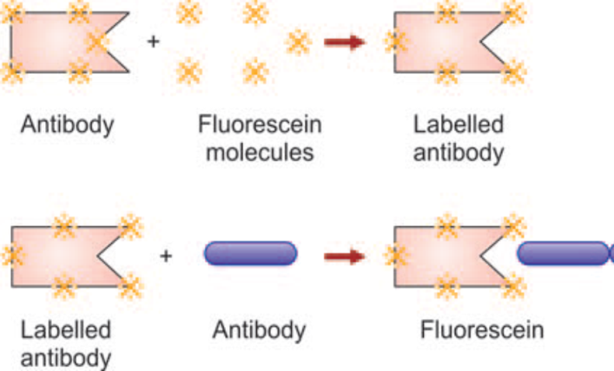
Types of fluorescent antibody methods are :
Direct method :It is commonly used for the detection of antigen by using of a known labeled antibody interact directly with unknown antigen .

Slide 20
b. Indirect method (double layer technique): it is two stage process ,a known antigen attached to a slide , unknown serum is added
the preparation is washed if the unknown serum antibody match the antigen remain fix on the slide
Detected by adding florescent labile anti-immunoglobulin .

Slide 21
Indirect method

Slide 22
c. Sandwich technique
Used for detection of antibody in tissue.
Tissue section is treated with dilute solution of antigen.
After washing (remove excess of antigen) section is exposed to fluorescein labelled antibodies.

Slide 23
Complement Dependent Serological Tests
1. Immune adherence test, i.e. some bacteria react with specific antibody in the presence of complement, aggregated and adhere to the cells, e.g.Vibrio cholerae, Treponema pallidum.
2. Complement fixation test.
3. Conglutinating complement absorption.
4. Immobilization test, e.g. Treponema pallidum.
5. Cytolytic or cytocidal test, e.g. Vibrio cholerae.
6. Opsonization.

Slide 24
ELISA Enzyme-Linked ImmunoSorbent Assay
An ELISA test uses components of the immune system (such as IgG or IgM antibodies) and chemicals for the detection of immune responses in the body (for example, to infectious microbes).
The ELISA test involves an enzyme (a protein that catalyzes a biochemical reaction).
It also involves an antibody or antigen (immunologic molecules).
The test depend on color change to identify a substance.

Slide 26
Principle of the test :
Antigens from the sample are attached to a surface.
Then, a further specific antibody is applied over the surface
bind to the antigen.
This antibody is linked to an enzyme, and, in the final step, a substance containing the enzyme's substrate is added.
The subsequent reaction produces a detectable signal, most commonly a color change in the substrate.

Slide 27
Types of ELISA tests
Direct ELISA: attachment of an antigen to a plate enzyme-labeled antibody that can react with the antigen .
Indirect ELISA: attachment of an antigen to a plate an nlabeled or primary antibody followed by an enzyme-labeled antibody that can react with both the primary antibody and substrate.
Sandwich ELISA
Competitive ELISA

Slide 29
What is the use of an ELISA test?
ELISA tests are primarily used for the detection of proteins (as opposed to small molecules and ions such as glucose and potassium).
The substances detected by ELISA tests can include
Hormones.
viral antigens (dengue fever, for example).
bacterial antigens (TB, for example).
and antibodies that the body has made in response to infection (antibodies to hepatitis B, for example) or vaccination.

Slide 30
Advantages of ELISA test
ELISA tests are generally good and accurate tests.
They are considered highly sensitive and specific compare with other methods used for the detection of substances in the body.
The ELISA testing method is more easier than older laboratory techniques, which often required radioactive materials

